Slide 1

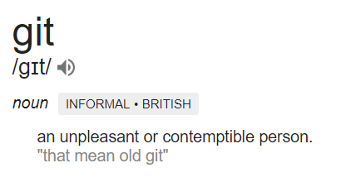
GIT FOR DUMMIES

Slide 2
SETUP
Download git for Windows / OSX / Linux
Create your account on Github / Bitbucket

Slide 3



THREE IMPORTANT STATES
working
directory
staging area
(index)
.git repository
(HEAD)
add
commit

Slide 4
GIT REPOSITORY
initializing a repository in an existing directory
$ cd /home/user/my_project
$ git init
or
cloning an existing repository
$ git clone <url>
Notes:
Cloning an Existing Repository: If you want to get a copy of an existing Git repository — for example, a project you’d like to contribute to — the command you need is git clone. Instead of getting just a working copy, Git receives a full copy of nearly all data that the server has. Every version of every file for the history of the project is pulled down by default when you run git clone. For example, if you want to clone the Git linkable library called libgit2, you can do so like this: $ git clone https://github.com/libgit2/libgit2 That creates a directory named libgit2, initializes a .git directory inside it, pulls down all the data for that repository, and checks out a working copy of the latest version. Git has a number of different transfer protocols you can use. The previous example uses the https:// protocol, but you may also see git:// or user@server:path/to/repo.git, which uses the SSH transfer protocol.

Slide 5


RECORDING CHANGES
untracked
tracked
unmodified
modified
staged
add the file
commit
edit the file
stage the file
remove the file
Notes:
At this point, you should have a bona fide Git repository on your local machine, and a checkout or working copy of all of its files in front of you. Typically, you’ll want to start making changes and committing snapshots of those changes into your repository each time the project reaches a state you want to record. Remember that each file in your working directory can be in one of two states: tracked or untracked. Tracked files are files that were in the last snapshot; they can be unmodified, modified, or staged. In short, tracked files are files that Git knows about. Untracked files are everything else — any files in your working directory that were not in your last snapshot and are not in your staging area. When you first clone a repository, all of your files will be tracked and unmodified because Git just checked them out and you haven’t edited anything. As you edit files, Git sees them as modified, because you’ve changed them since your last commit. As you work, you selectively stage these modified files and then commit all those staged changes, and the cycle repeats.

Slide 6
ADD & COMMIT
$ git add *
$ git add <filename>
$ git commit
-m “commit message”
-a
add shortcut
Now the file is committed to the HEAD, but not in your remote repository yet.

Slide 7
GIT STATUS vs. GIT DIFF
$ git status
-s
“nothing to commit, working directory clean”
“untracked files:”
“changes to be committed:”
“changes not staged for commit:”
“new file:”
“modified:”
$ git diff
--staged
untracked vs. staged
staged vs. committed
Notes:
What have you changed but not yet staged? And what have you staged that you are about to commit? Although git status answers those questions very generally by listing the file names, git diff shows you the exact lines added and removed — the patch, as it were.

Slide 8
(RE)MOVE / IGNORE
$ git rm <filename>
$ touch .gitignore
--cached
*.xml
if you simply remove the file from your working directory, it shows up under the “Changes not staged for commit” (“deleted:”)
$ git mv file_from file_to
you can use any tool you like to rename a file, and address the add/rm later, before you commit

Slide 9
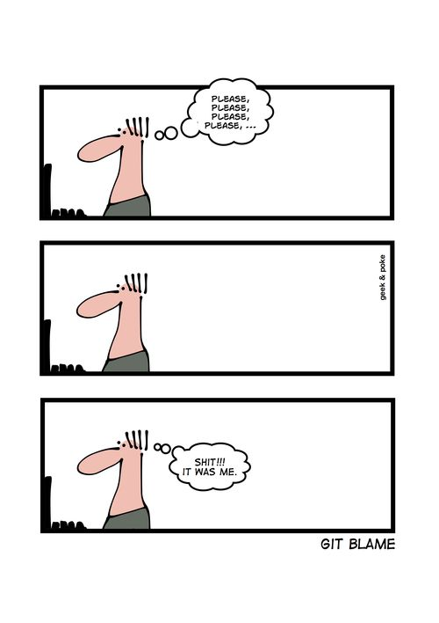
Viewing the Commit History
$ git log
--patch
/
-p
-2
--stat
--all-match
--pretty=format
--author=name
--grep=word
--help
this command lists each commit with its SHA-1 checksum, the author’s name and email, the date written, and the commit message.

Slide 10
Undoing Things
$ git checkout -- <filename>
unmodifying a modified file
$ git reset HEAD <filename>
unstaging a staged file
$ git commit --amend
when you commit too early and possibly forget to add some files, or you mess up your commit message

Slide 11
WORKING WITH REMOTES
$ git clone <url>
$ git remote add <shortname> <url>
adding remote repositories
$ git remote -v
lists remote repositories
pulling
pushing
$ git fetch <remote>
just downloads
git push <remote> <branch>
tries to merge
you’ll have to fetch others work first before you’ll be allowed to push / along with write access
$ git pull

Slide 12
RENAME / REMOVE REMOTE
$ git remote rename <remotename> <newname>
$ git remote remove <remotename>
$ git remote show <remotename>
if you want to see more information about a particular remote

Slide 13
BRANCHIN’
$ git branch <name>
=
$ git checkout -b <name>
$ git checkout <name>
$ git push -u <remote> <branch>
or
$ git checkout master
$ git branch -d <branch>

Slide 14
or
pull request on Bitbucket
merge request on Github

Slide 15
STASHIN’
$ git add <file>
$ git status
$ git stash (push)
$ git stash list
goes to most recent
$ git stash apply
=
$ git stash pop
$ git stash drop

Slide 16
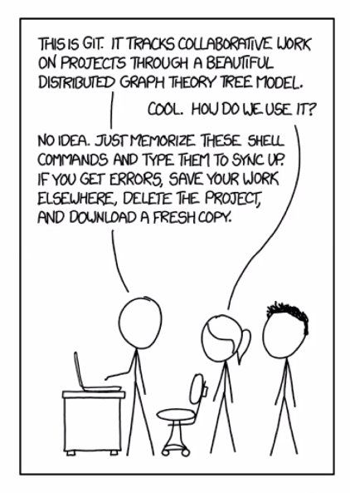
USEFUL HINTS & LINKS
$ gitk
git GUI
https://git-scm.com/book/en/v2
https://git-scm.com/docs

